Slide 1
Applied Statistics, Probability theory and mathematical statistics
István Fazekas, Attila Barta, Sándor Pecsora
Conditional probability, Bayes' theorem
”This work was supported by the construction EFOP-3.4.3-16-2016-00021. The project was supported by the European Union, co-financed by the European Social Fund.”

Slide 2





Exercise 5.4 (M2)
Two dice are rolled. Find the probability that the sum of the numbers obtained is 7 given the sum is odd.
$$A −the sum is 7 \\ B −the sum is odd$$
$$P\left(A|B\right)=\frac{P\left(AB\right)}{P\left(B\right)}$$
6 | 7 | 8 | 9 | 10 | 11 | 12
5 | 6 | 7 | 8 | 9 | 10 | 11
4 | 5 | 6 | 7 | 8 | 9 | 10
3 | 4 | 5 | 6 | 7 | 8 | 9
2 | 3 | 4 | 5 | 6 | 7 | 8
1 | 2 | 3 | 4 | 5 | 6 | 7
 | 1 | 2 | 3 | 4 | 5 | 6
$$P\left(AB\right)=\frac{6}{36}$$
$$P\left(B\right)=\frac{18}{36}$$
$$P\left(A|B\right)=\frac{6/36}{18/36}=\frac{6}{18}=1/3$$

Slide 3
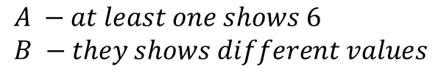




Exercise 5.5 (M3)
Two dice are rolled. Find the probability that at least one of them shows six, given they show different values.
Hint:
$$A −at least one shows 6 \\ B −they shows different values$$
6 | (1;6) | (2;6) | (3;6) | (4;6) | (5;6) | (6;6)
5 | (1;5) | (2;5) | (3;5) | (4;5) | (5;5) | (6;5)
4 | (1;4) | (2;4) | (3;4) | (4;4) | (5;4) | (6;4)
3 | (1;3) | (2;3) | (3;3) | (4;3) | (5;3) | (6;3)
2 | (1;2) | (2;2) | (3;2) | (4;2) | (5;2) | (6;2)
1 | (1;1) | (2;1) | (3;1) | (4;1) | (5;1) | (6;1)
 | 1 | 2 | 3 | 4 | 5 | 6
$$P\left(A|B\right)=\frac{P\left(AB\right)}{P\left(B\right)}$$
$$P\left(AB\right)=\frac{10}{36}$$
$$P\left(B\right)=\frac{30}{36}$$
$$P\left(A|B\right)=\frac{10/36}{30/36}=\frac{10}{30}=1/3$$

Slide 4
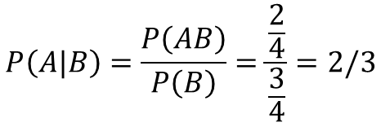
Exercise 5.7
We know that at least one of the two kids in a family is a girl. Find the probability of having also a boy in the family.
$$P\left(A|B\right)=\frac{P\left(AB\right)}{P\left(B\right)}=\frac{\frac{2}{4}}{\frac{3}{4}}=2/3$$

Slide 5









Exercise 5.8*
Choose two points randomly from the unit interval. Find the probability that both points are closer to a previously specified end point of the interval, given their distance is less than 1/2.
$$−\frac{1}{2}<y−x<\frac{1}{2}$$
Hint:
$$y=x+\frac{1}{2}$$
$$P\left(A|B\right)=\frac{P\left(AB\right)}{P\left(B\right)}$$
$$y=x−\frac{1}{2}$$
$$P\left(B\right)=\frac{3}{4}$$
$$\frac{1}{2}$$
$$P\left(AB\right)=\frac{1}{4}$$
$$P\left(A|B\right)=\frac{1}{3}$$
$$\frac{1}{2}$$

Slide 6

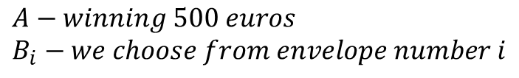


Exercise 5.14
In a TV quiz show the player must choose one from three envelopes. In the first envelope there are 5 cards saying 'Sorry, next time', 3 cards with 'You have won 100 euros' and 2 cards with 'You have won 500 euros'. The content of the second envelope: 2 cards 'Sorry, next time', 7 cards 'You have won 100 euros' and 1 card 'You have won 500 euros'. The third envelope contains only 'Sorry, next time' cards. The player chooses randomly an envelope and from the chosen envelope he chooses a card. What is the probability that the player wins 500 euros?
$$A−winning 500 euros \\ B_{i}−we choose from envelope number i$$
$$P\left(A|B_{1}\right)=\frac{2}{10}$$
$$P\left(A|B_{2}\right)=\frac{1}{10}$$
$P\left(A|B_{3}\right)=$0
$$P\left(A\right)=P\left(A|B_{1}\right)P\left(B_{1}\right)+P\left(A|B_{2}\right)P\left(B_{2}\right)+P\left(A|B_{3}\right)P\left(B_{3}\right)=\frac{1}{10}$$

Slide 7
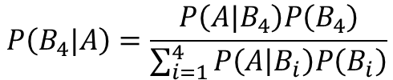
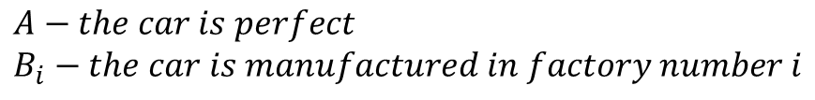

Exercise 5.19
Rust Rider cars are produced in four factories. The first factory produces 200 cars per day, the second 320, the third 270, while the fourth 210. The refuse ratios for the factories are 2%; 5%; 3% and 1%, respectively. We bought a Rust Rider and we found it perfect. What is the probability that it had been produced in the fourth factory?
$$A−the car is perfect \\ B_{i}−the car is manufactured in factory number i$$
$$P\left(B_{4}|A\right)=\frac{P\left(A|B_{4}\right)P\left(B_{4}\right)}{\sum_{i=1}^{4}{P\left(A | B_{i}\right)P\left(B_{i}\right)}}$$
$$P\left(B_{4}|A\right)=\frac{2079}{9698}$$

Slide 8

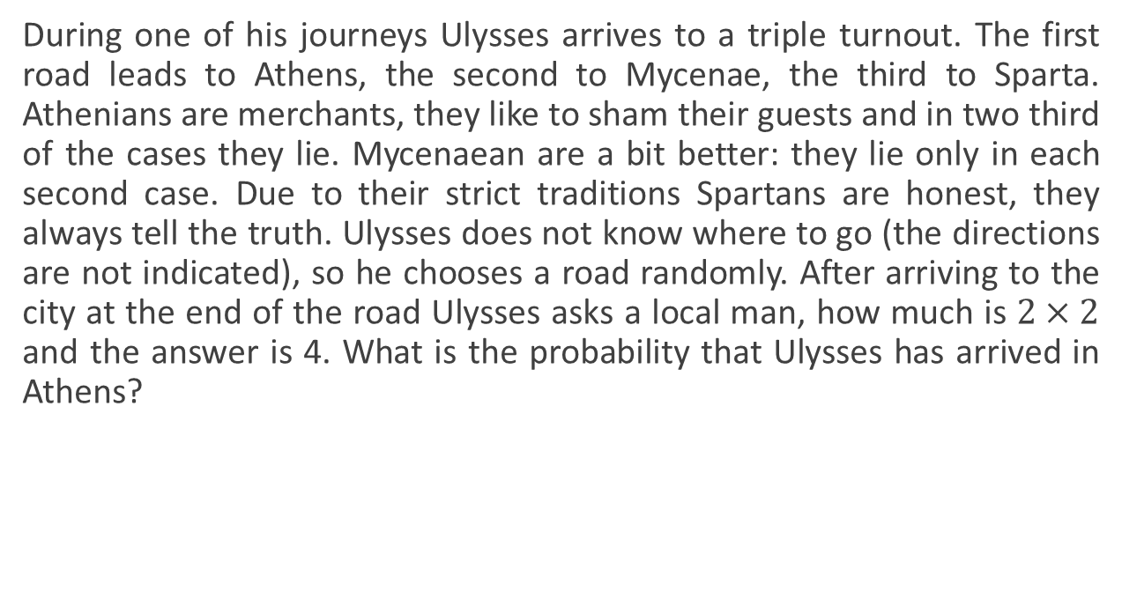

Exercise 5.22
During one of his journeys Ulysses arrives to a triple turnout. The first road leads to Athens, the second to Mycenae, the third to Sparta. Athenians are merchants, they like to sham their guests and in two third of the cases they lie. Mycenaean are a bit better: they lie only in each second case. Due to their strict traditions Spartans are honest, they always tell the truth. Ulysses does not know where to go (the directions are not indicated), so he chooses a road randomly. After arriving to the city at the end of the road Ulysses asks a local man, how much is $2×2$ and the answer is 4. What is the probability that Ulysses has arrived in Athens?
$$A_{1}− arrived to Athens \\ A_{2}− arrived to Micenae \\ A_{3}−arrived to Sparta \\ B− answer is true$$
$$P\left(A_{1}|B\right)=\frac{P\left(B|A_{1}\right)P\left(A_{1}\right)}{P\left(B\right)}=\frac{2}{11}$$

Slide 9
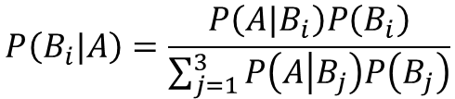
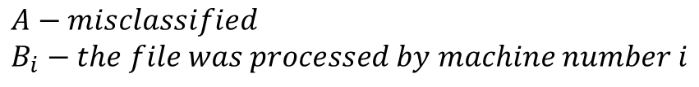
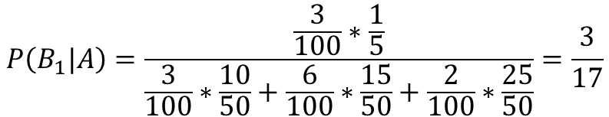
Exercise 5.24
In an office equipped with mechanized administration three machines classify the files. The first can process 10 files per day, the second 15, while the third 25. The average numbers of misclassified files are 0.3, 0.9 and 0.5 per day, respectively. We choose a file randomly from the daily production and we find that it has been misclassified. What is the probability that the file was processed by the first machine?
$$A−misclassified \\ B_{i}−the file was processed by machine number i$$
$$P\left(B_{i}|A\right)=\frac{P\left(A|B_{i}\right)P\left(B_{i}\right)}{\sum_{j=1}^{3}{P\left(A | B_{j}\right)P\left(B_{j}\right)}}$$
$$P\left(B_{1}|A\right)=\frac{\frac{3}{100}∗\frac{1}{5}}{\frac{3}{100}∗\frac{10}{50}+\frac{6}{100}∗\frac{15}{50}+\frac{2}{100}∗\frac{25}{50}}=\frac{3}{17}$$

Slide 10
Exercise M1
Write a MATLAB code, that simulates 100000000 coin tosses and stores the result of all the tosses in a single row vector! (head=0, tail=1)
Count the number of heads and tails and display the result!
tic
n=100000000
v=rand(1,n);
for i=1:n
if v(i)<0.5
v(i)=0;
else v(i)=1;
end
end
sum(v)
toc
tic
v2=randi(2,1,100000000)-1;
sum(v2)
toc

Slide 11
Exercise M2
Write a MATLAB code, that simulates the experiment in Exercise 5.4!
Two dice are rolled. Find the probability that the sum of the numbers obtained is 7 given the sum is odd.
s=0;
k=0;
for i=1:1000000
p=randi(6,1,2);
if rem(sum(p),2)==1
s=s+1;
if sum(p)==7
k=k+1;
end
end
end
disp('Number of cases when the sum is odd:')
s
disp('Number of cases when the sum is seven:')
k
k/s

Slide 12
Exercise M3
Write a MATLAB code, that simulates the experiment in Exercise 5.5!
Two dice are rolled. Find the probability that at least one of them shows six, given they show different values.
s=0;
k=0;
for i=1:1000000
p=randi(6,1,2);
if p(1)~=p(2)
s=s+1;
if p(1)==6 | p(2)==6
k=k+1;
end
end
end
disp('Number of cases when they show different values:')
s
disp('Number of cases when at least one of them shows six:')
k
k/s

Slide 13
Literature
Ágnes Baran: Mathematics for engineers 1. (Laboratory slides)
Sándor Baran: Probability theory and statistics
Fazekas István: Valószínűségszámítás, Debreceni Egyetemi Kiadó, 2009
Fazekas István: Bevezetés a matematikai statisztikába, Debreceni Egyetemi Kiadó, 2009
Matlab examples: https://www.mathworks.com/help/examples.html

